Slide 1









FLEX
Your own Food & Workout assistant

Slide 2
TABLE OF CONTENTS
01
02
03
Overall Progress
Completed tasks
Next week plan

Slide 3
01
Overall Progress

Slide 4
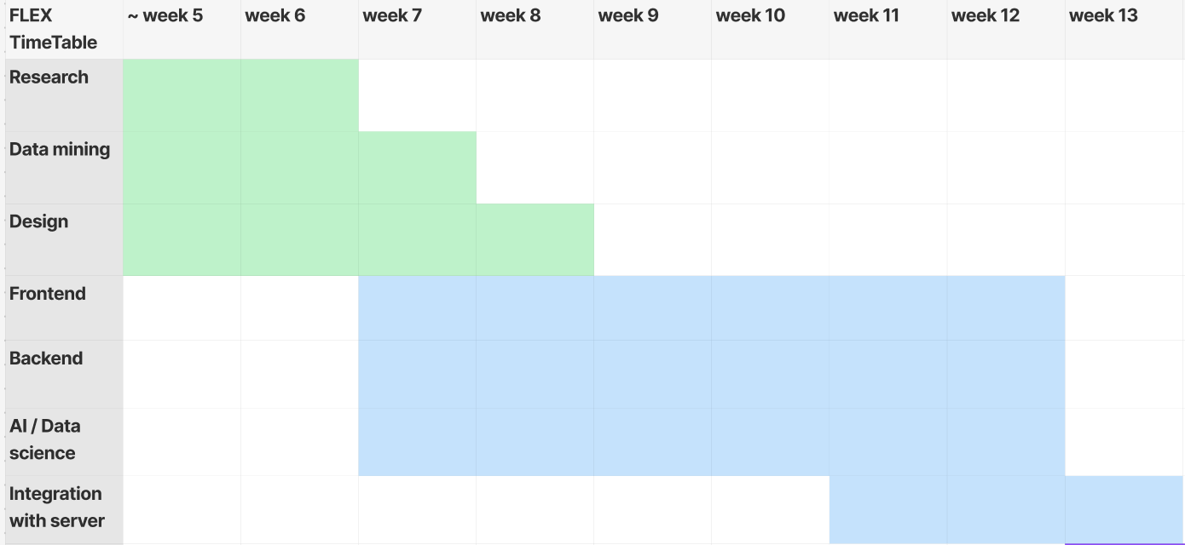
Overall Progress

Slide 5
02
Completed tasks

Slide 6
Tasks Completed This Week
1. Backend
a. Database Design Modification
b. Exercise related API
c. Exercise Recommendation Logic
d. Goal-based Calorie Limit Logic
2. Frontend
a. Make every pages
b. Integration with server
c. Auto-login
d. Popup page for register allergic

Slide 7
Tasks Completed This Week
3. AI
a. Improve the sentiment analysis score
b. Cleaning
c. Get synthetized images
d. Prepare the model

Slide 8
02-1
Backend

Slide 9
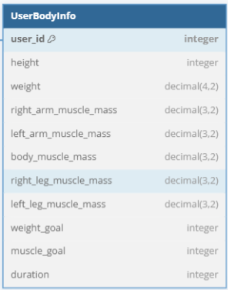
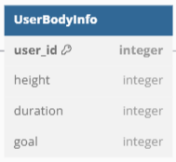
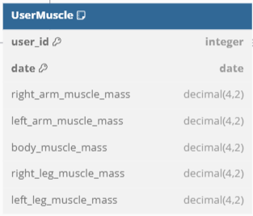
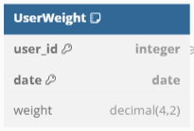
Database Design Modification
Splitted UserBodyInfo Table into three tables. Users might update their weight and muscle mass on different date.
UserBodyInfo.goal: +1: bulk up, 0: normal, -1: lose weight

Slide 10
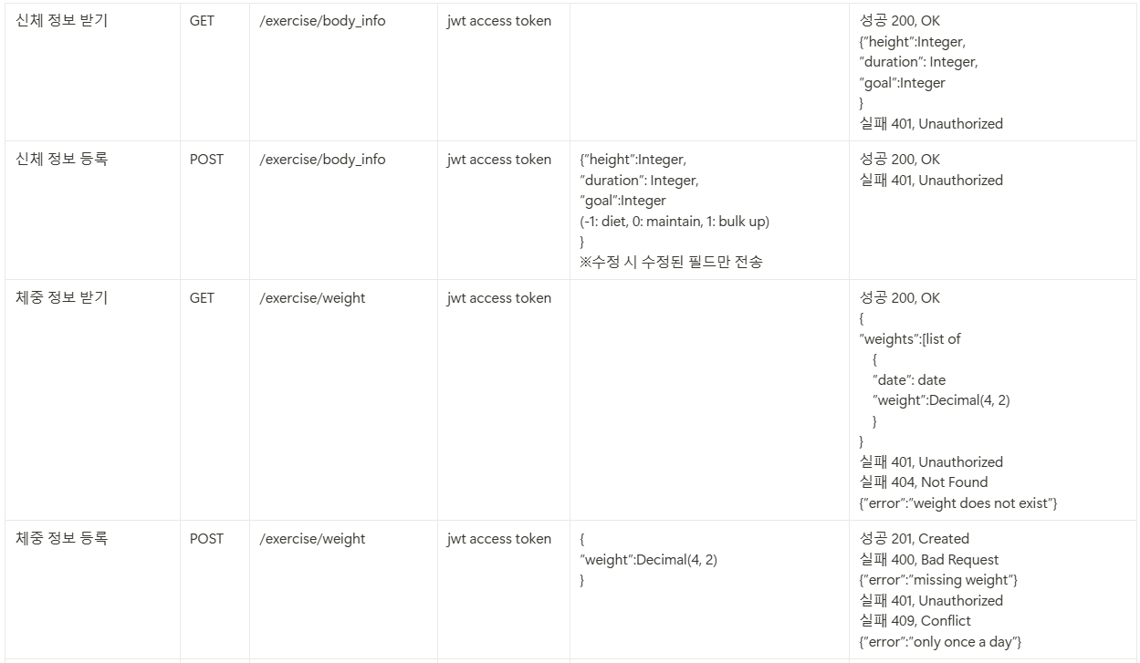
Exercise related API
Apis for users’ body info and weight

Slide 11
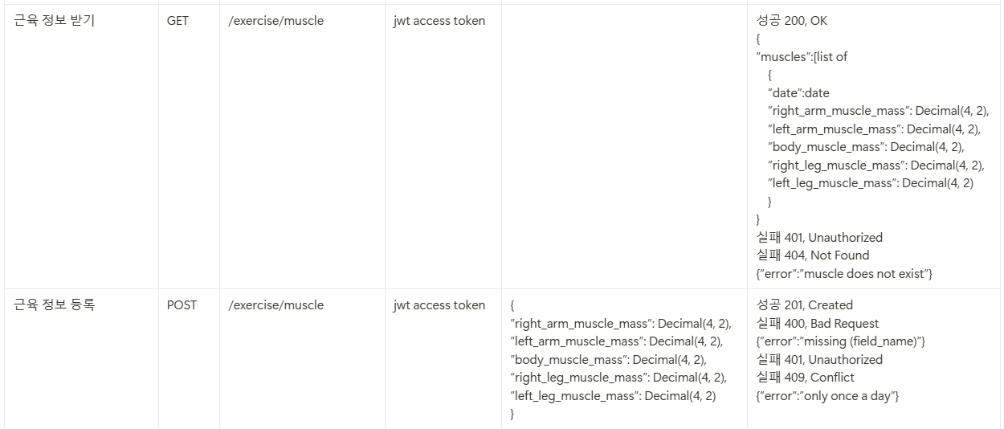
Exercise related API
Apis for users’ muscle mass

Slide 12
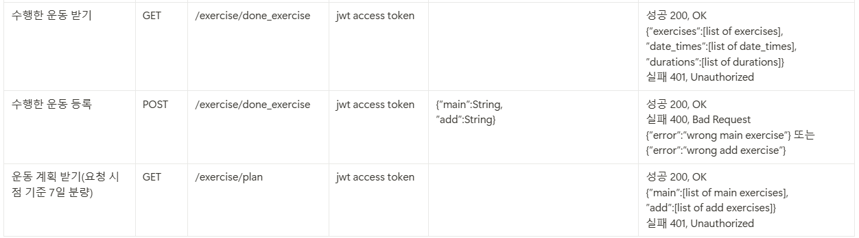
Exercise related API
Apis for users’ exercise plan

Slide 13
Exercise Recommendation Logic
Assumption
Exercise Recommend only considers user’s muscle mass
Two Recommendations (pairs)
Main(chest, back, legs)
Additional(arms, shoulders, abs)
If users didn’t enter their muscle information -> recommend default plan
If users update their muscle information
-> immediately recommend new plan

Slide 14
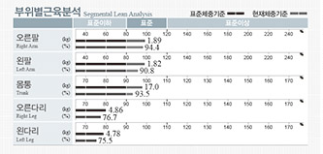
Exercise Recommendation Logic
Calculate muscle mass differences(percentage)
Main: d = body muscle mass - legs muscle mass
Additional: d = body muscle mass - arms muscle mass

Slide 15
Exercise Recommendation Logic
Main ( body means doing chest and back alternatively)
Default
body -> legs -> body -> repeat
10 <= d <= 20
body -> legs -> repeat
d >= 20
legs -> body -> legs -> body -> legs -> repeat
-20 <=d <= -10
body -> body -> body -> legs -> repeat
d <= -20
body -> body -> body -> body -> legs -> repeat

Slide 16
Exercise Recommendation Logic
Additional
Default:
arms -> shoulders -> abs -> repeat
10 <= d <= 20:
arms -> shoulders -> arms -> abs -> repeat

Slide 17
Exercise Recommendation Logic
Example
Main: default, Additional: 10 <= d <= 20
(chest, arms) -> (legs, shoulders) -> (back, arms)-> (chest, abs) -> (legs, arms) -> (back, shoulders) -> ···
Main: -20 <= d <= -10, Additional: default
(chest, arms) -> (back, shoulders) -> (chest, abs) -> (legs, arms)-> (back, shoulders)->(chest, abs) -> ···

Slide 18
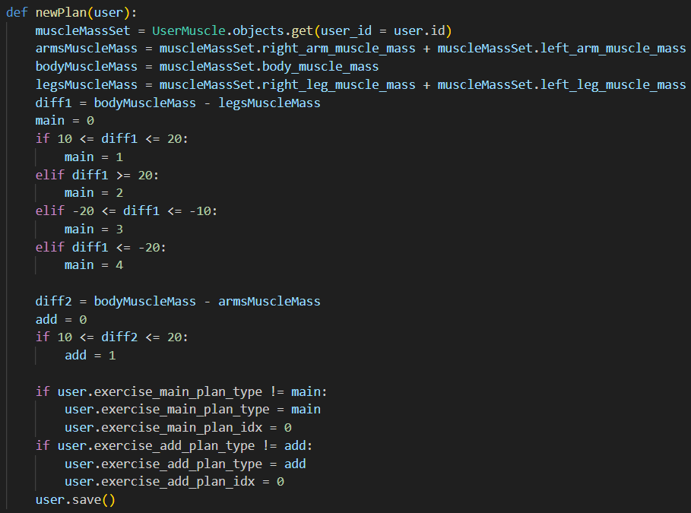
Exercise Recommendation Logic
Implementation

Slide 19
Goal-based Calorie Limit Logic
Assumption
Users enter their weight every 5 days
Users select 3 foods a day
1. Calculate user’s weight difference between nth date and (n+5)th date
2. Calculate user’s calorie intake from (n+1)th date to (n+5)th date
3. Repeat for k times (if user’s using app for 20 days, k = 4)

Slide 20
Goal-based Calorie Limit Logic
4. Result (example)
First 5 days: a calorie / b weight difference
Second 5 days: c calorie / d weight difference
Third 5 days : e calorie / f weight difference
5. For two consecutive datas, Find X that
makes X calorie / 0 weight difference
-> X = a - b * (c-a)/(d-b)
6. Exclude if (c-a)*(d-b) <= 0 -> upto (k-1) Xs If all datas are excluded, don’t limit calorie.

Slide 21
Goal-based Calorie Limit Logic
7. Calculate the mean of all Xs (let it be m)
8. Then we can assume that if user’s calorie intake for 5 days is m, user’s weight will be maintained.
-> user’s calorie intake for a meal is (m/15)
9. Limit calorie based on user’s goal
If user’s goal is 1 ( bulk up), more than (m/15) for a meal
If user’s goal is 0 (normal), don’t limit
If user’s goal is -1 (lose weight), less than (m/15) for a meal

Slide 22
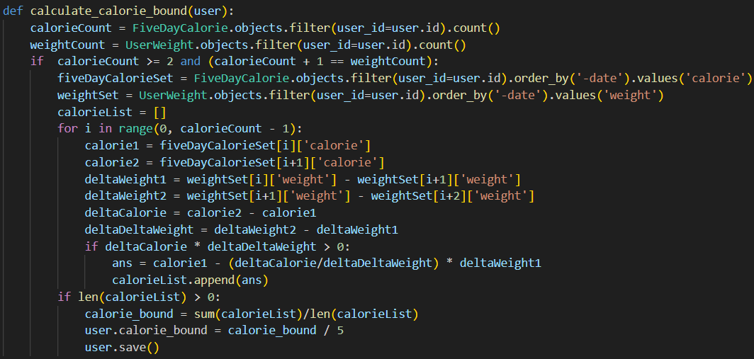
Goal-based Calorie Limit Logic
Implementation

Slide 23
02-2
Frontend

Slide 24
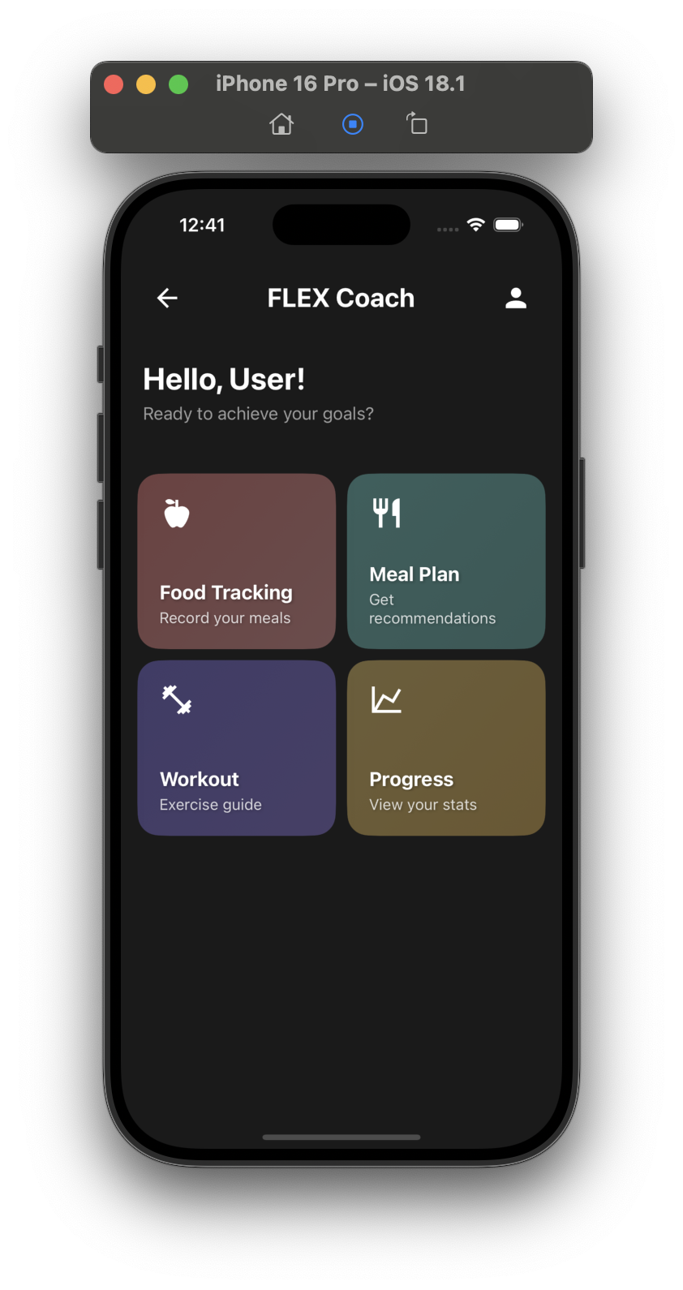
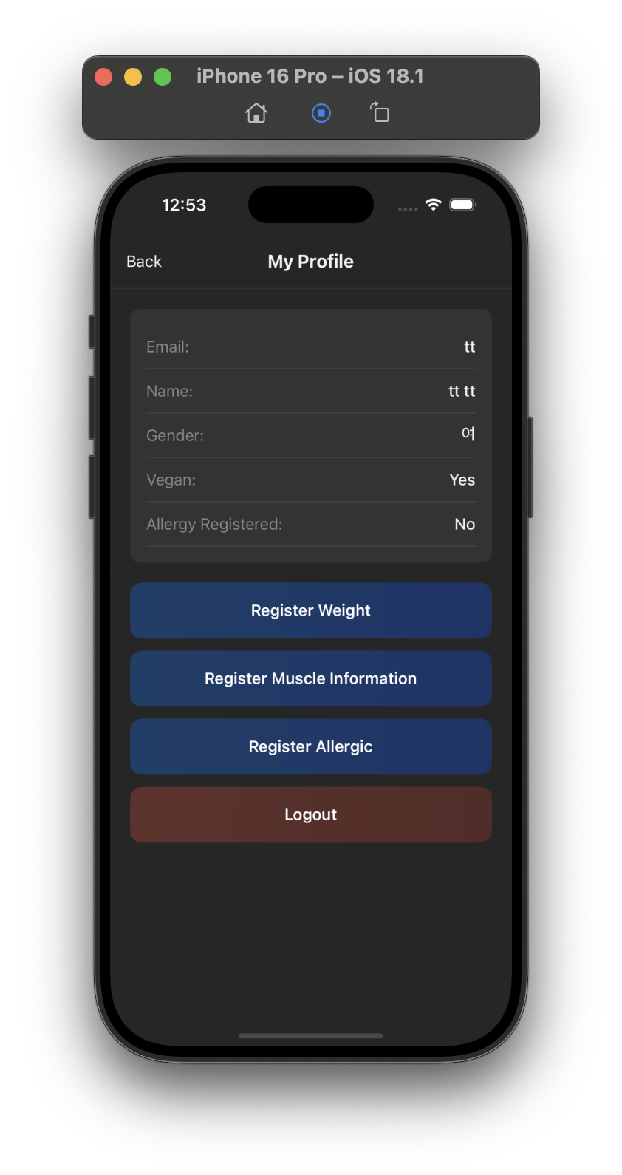
Make pages
Make every pages
And make connection with server

Slide 25
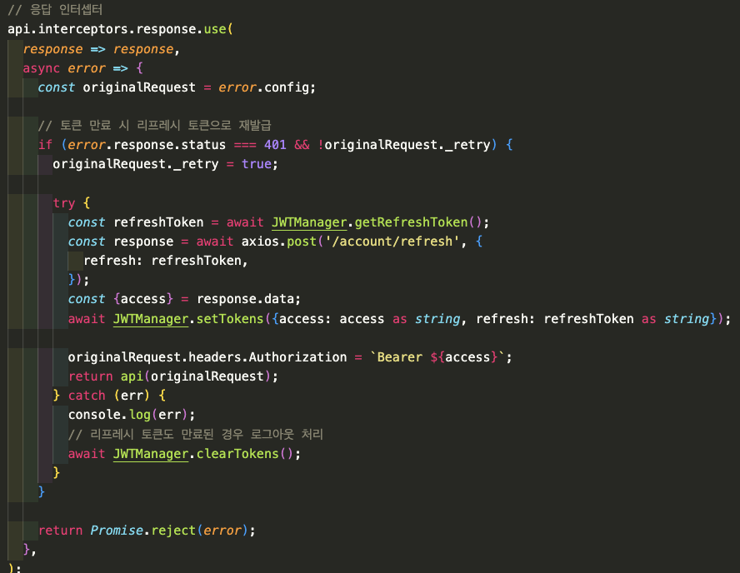
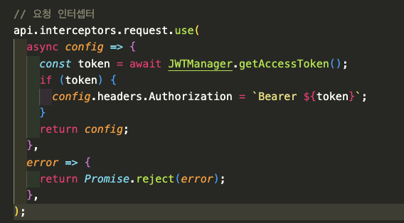
Axios config for req & res
Api interceptors for with axios

Slide 26
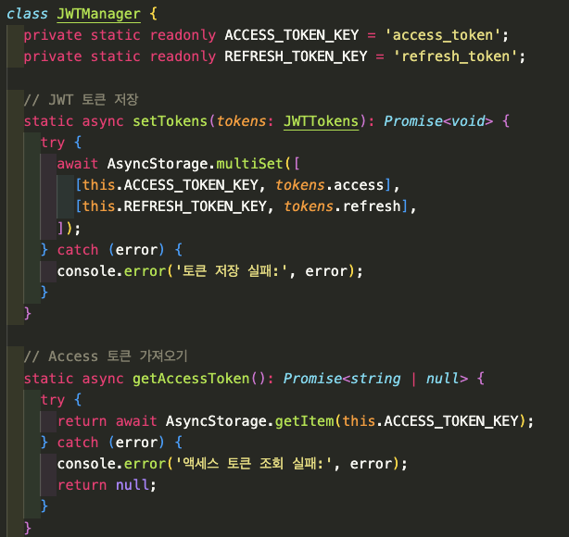
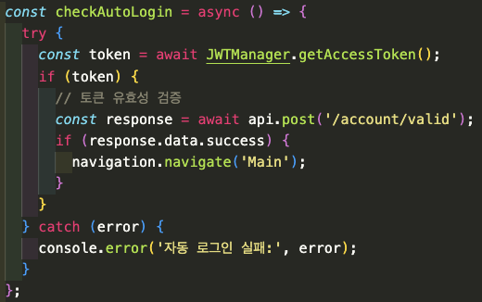
Auto Login
Make JWTManager for handling jwt token
With async storage , JWTManager
=> Auto login

Slide 27
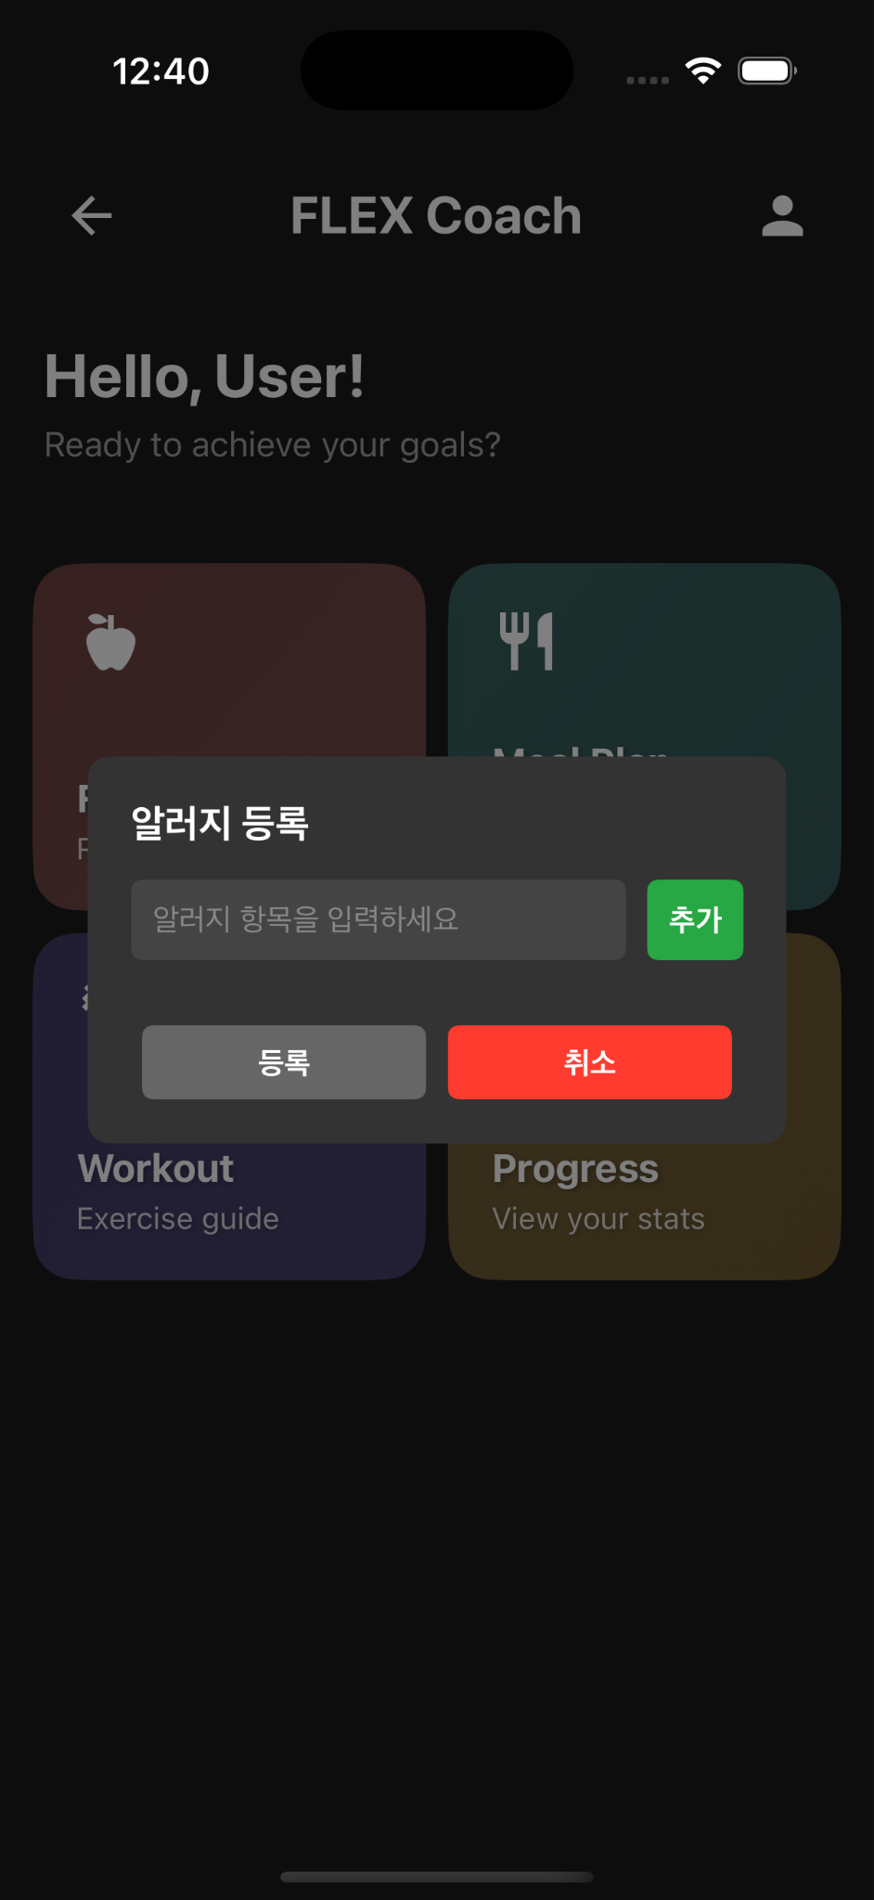
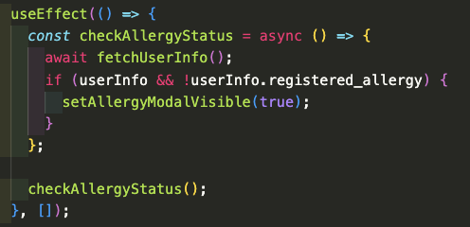
Make users to fill their own Allergy list
When user enter Main page, check users Allergy list.
If user didn’t fill Allergy list, then popup page is open.

Slide 28
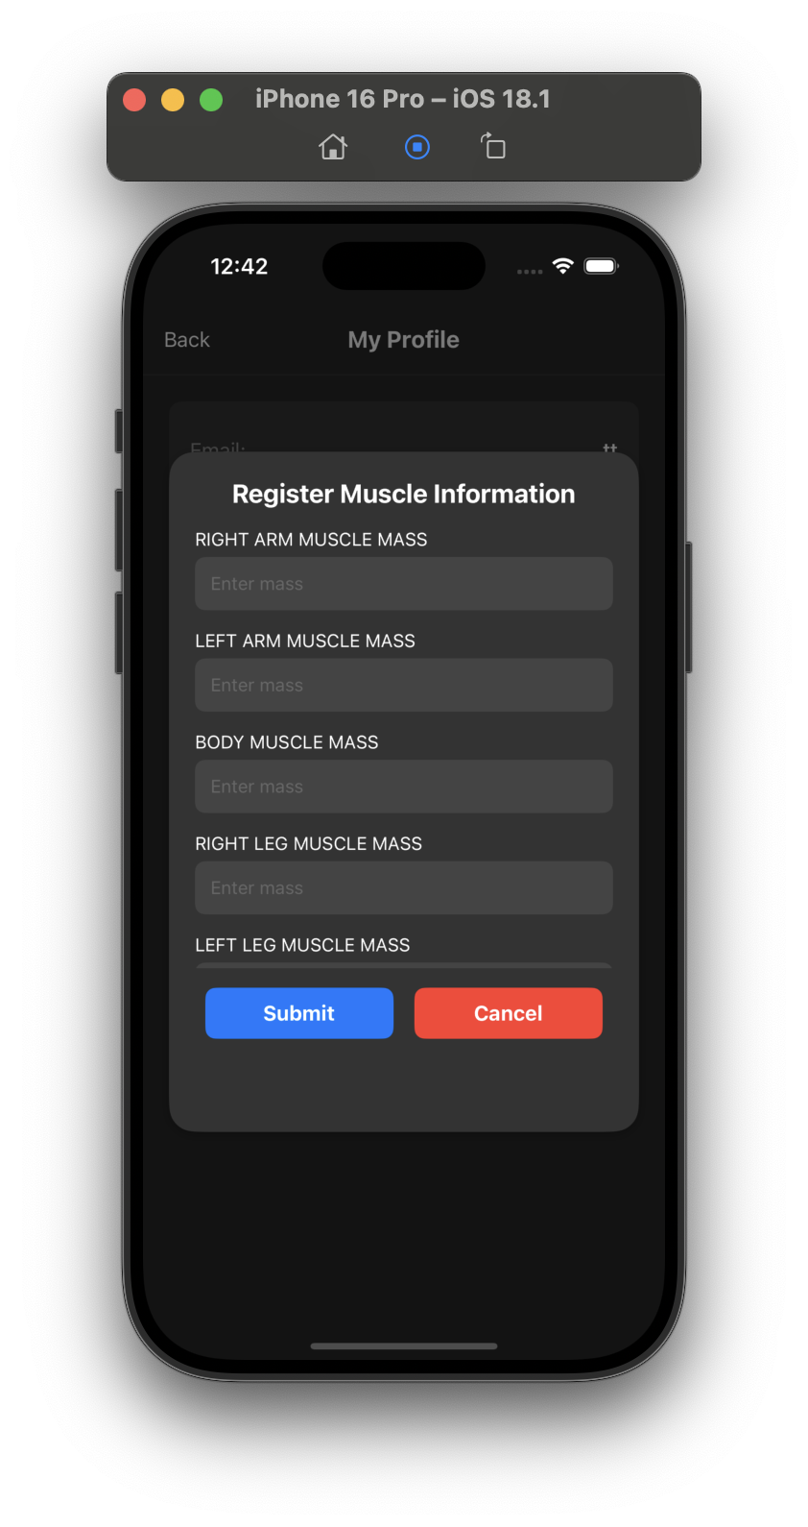
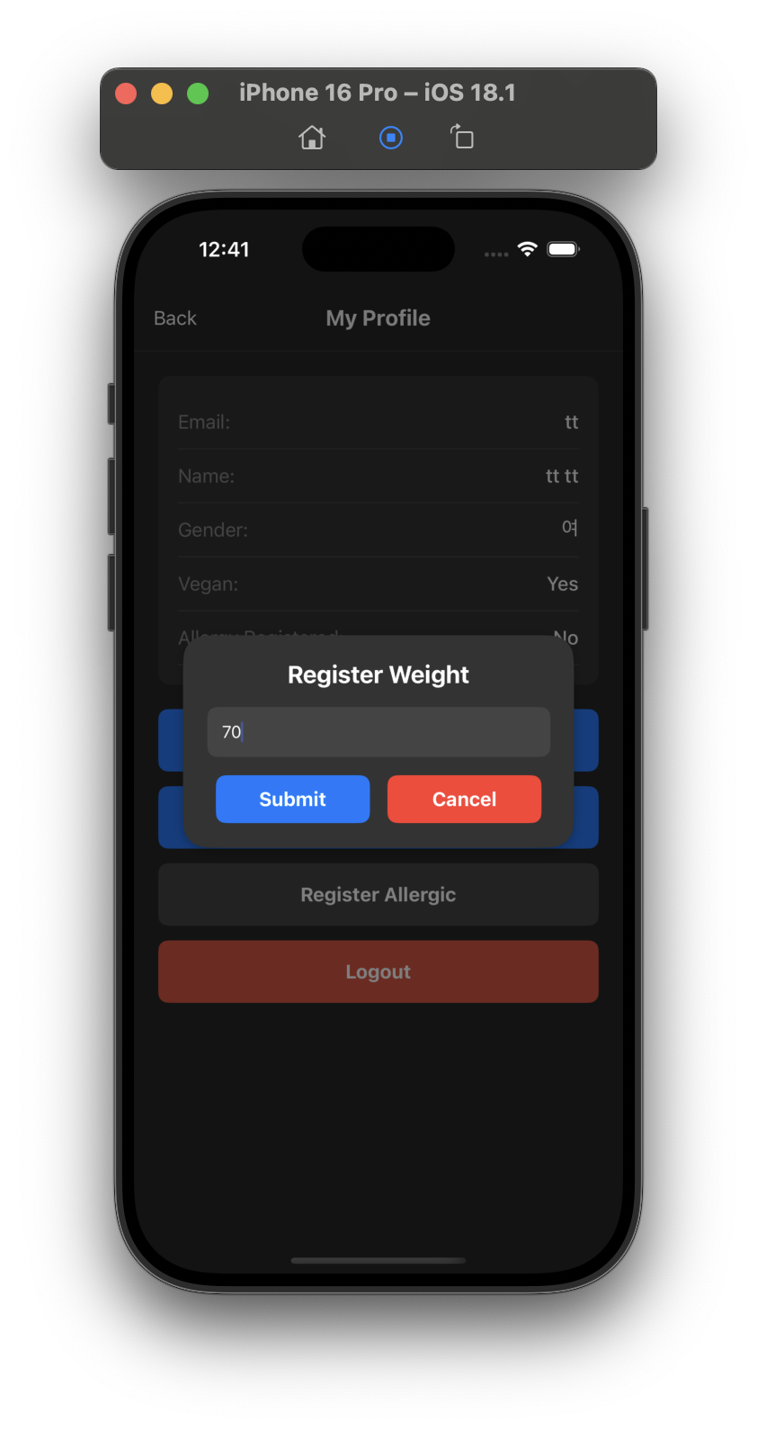
Make users to fill their own Weight & Muscle
Like Allergy, We check Users weight at intervals of 5 days.
We don’t Check Muscle mass at interval. But we recommend to fill it.

Slide 29
02-3
AI
Keyword Extraction

Slide 30
Main idea
FOOD DESCRIPTION
Keywords extraction
NER, POS tagging, entities…
Clean useless keywords
USER’S MESSAGE
Same keywords extraction as food description + comparing list of keywords
We look for quantity
Analyze the similarity between keywords + sentiment
Score the food

Slide 31
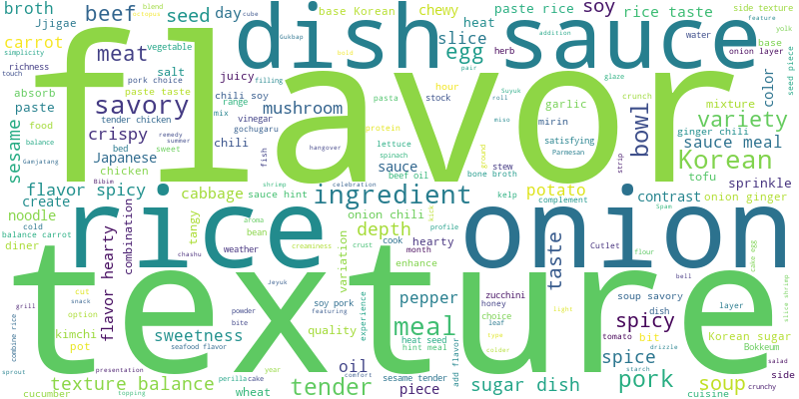
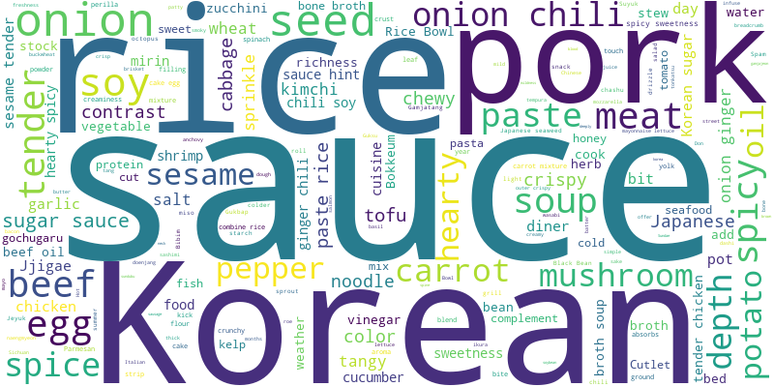
Description Keywords
All keywords before cleaning
All keywords after cleaning

Slide 32
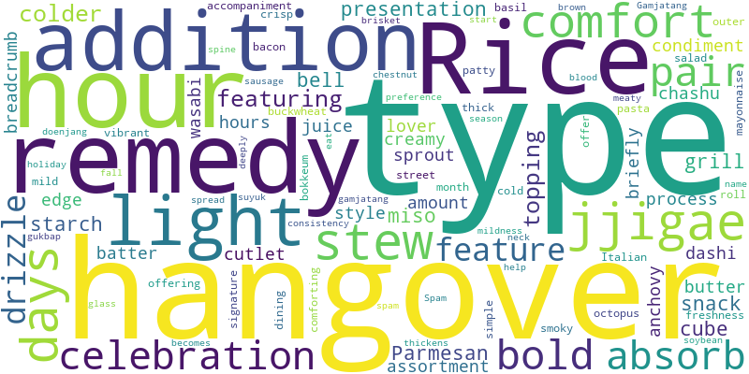
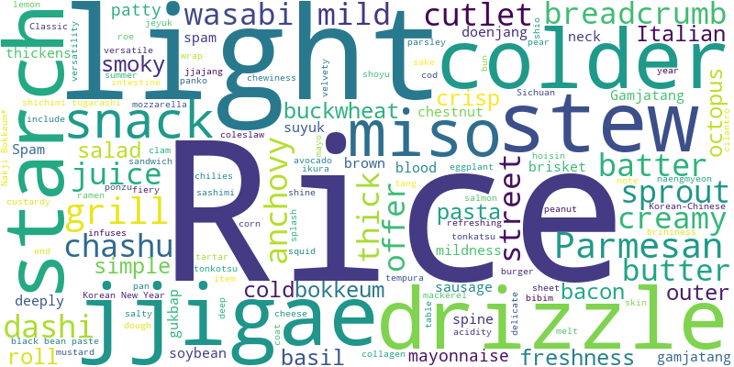
Description Keywords
All keywords <5 frequency before cleaning
All keywords <5 frequency after cleaning

Slide 33
User’s Keywords Evaluation
Chat GPT → Create small dataset to evaluate our method
Message: I feel like eating something spicy tonight.
Positive Keywords: spicy
Negative Keywords: None
Same way as description + Looking for same keywords as descriptions’ keywords set→ 70%

Slide 34
Sentiment Analysis
Aspect-Based Sentiment Analysis (ABSA) Using DeBERTa Model
50% Accuracy
Neutral keywords problem
3 Logits → 2 Logits (Positive & Negative)
97% Accuracy (33/34 messages)

Slide 35
02-4
AI
Object detection of ingredient

Slide 36
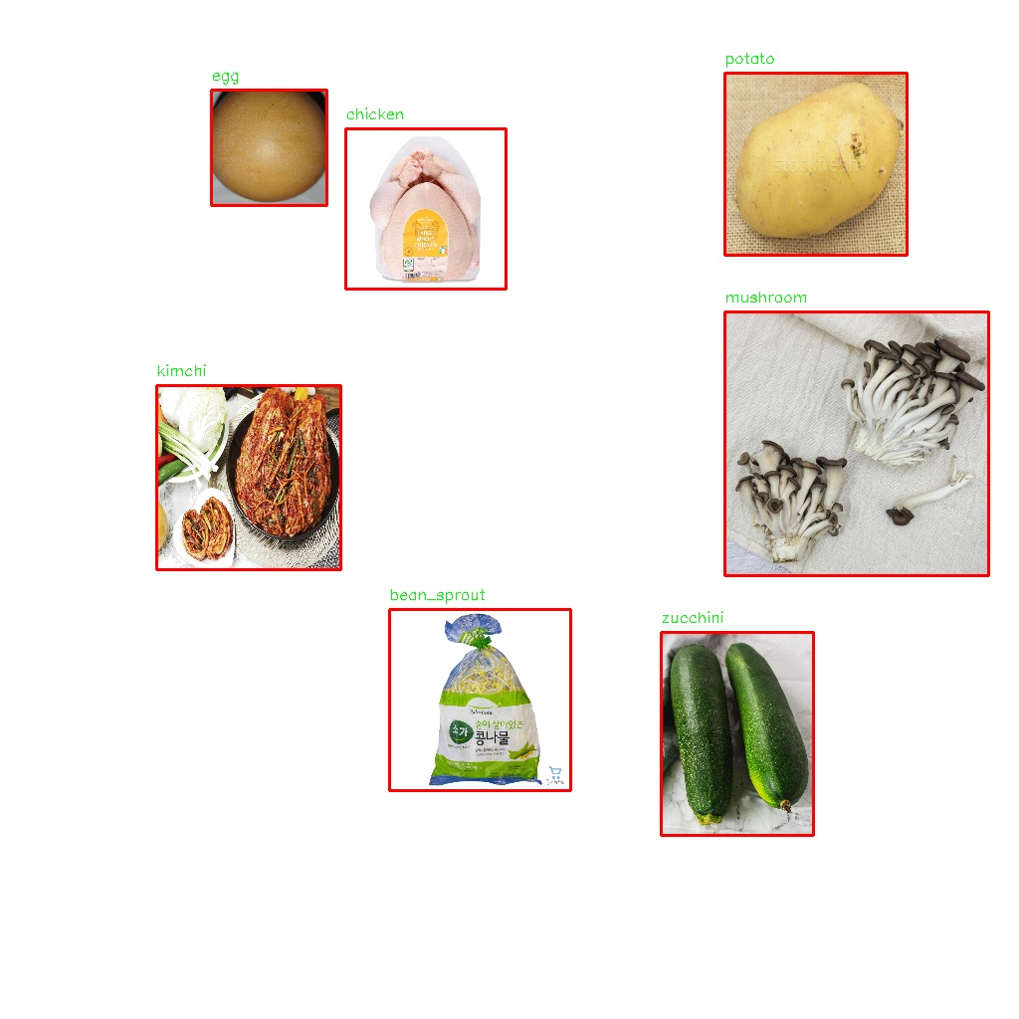
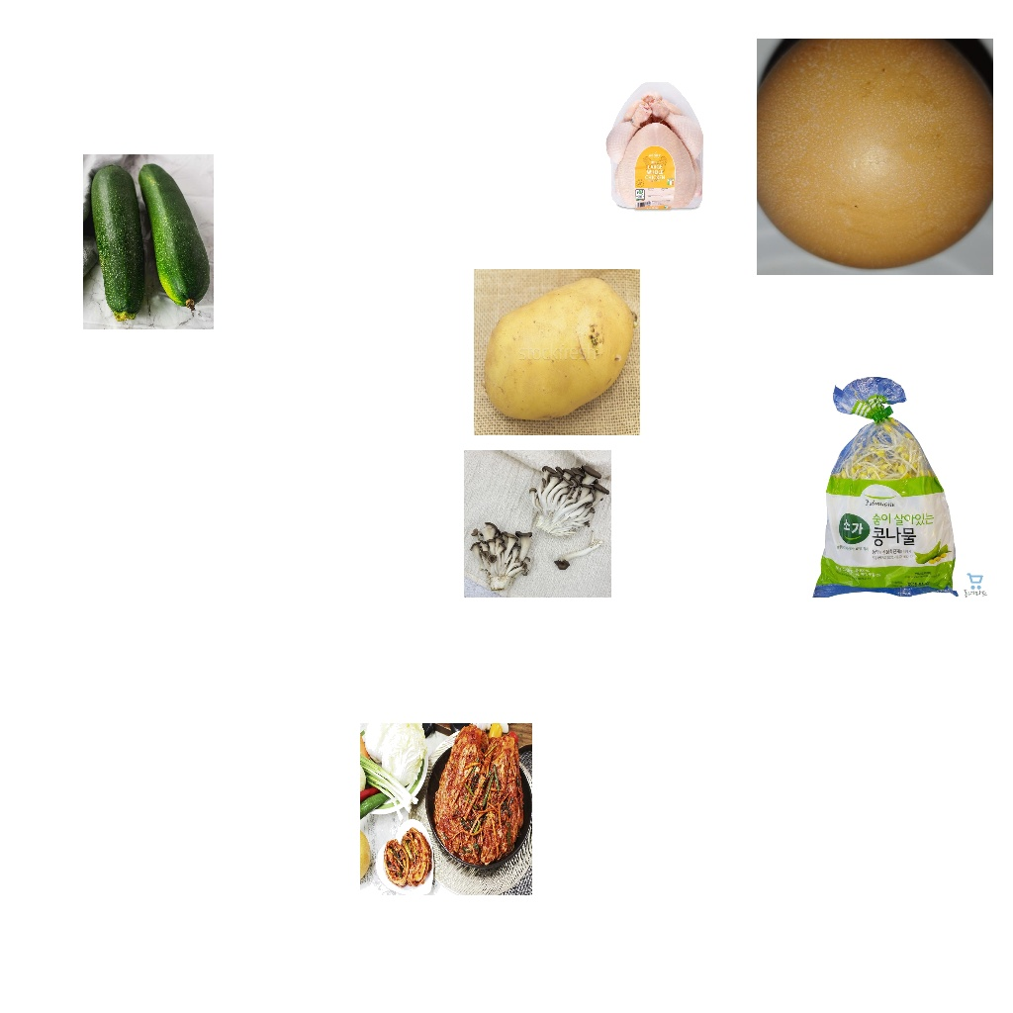
Overview of the model
Take a photo of user groceries
before organizing them in the refrigerator

Slide 37
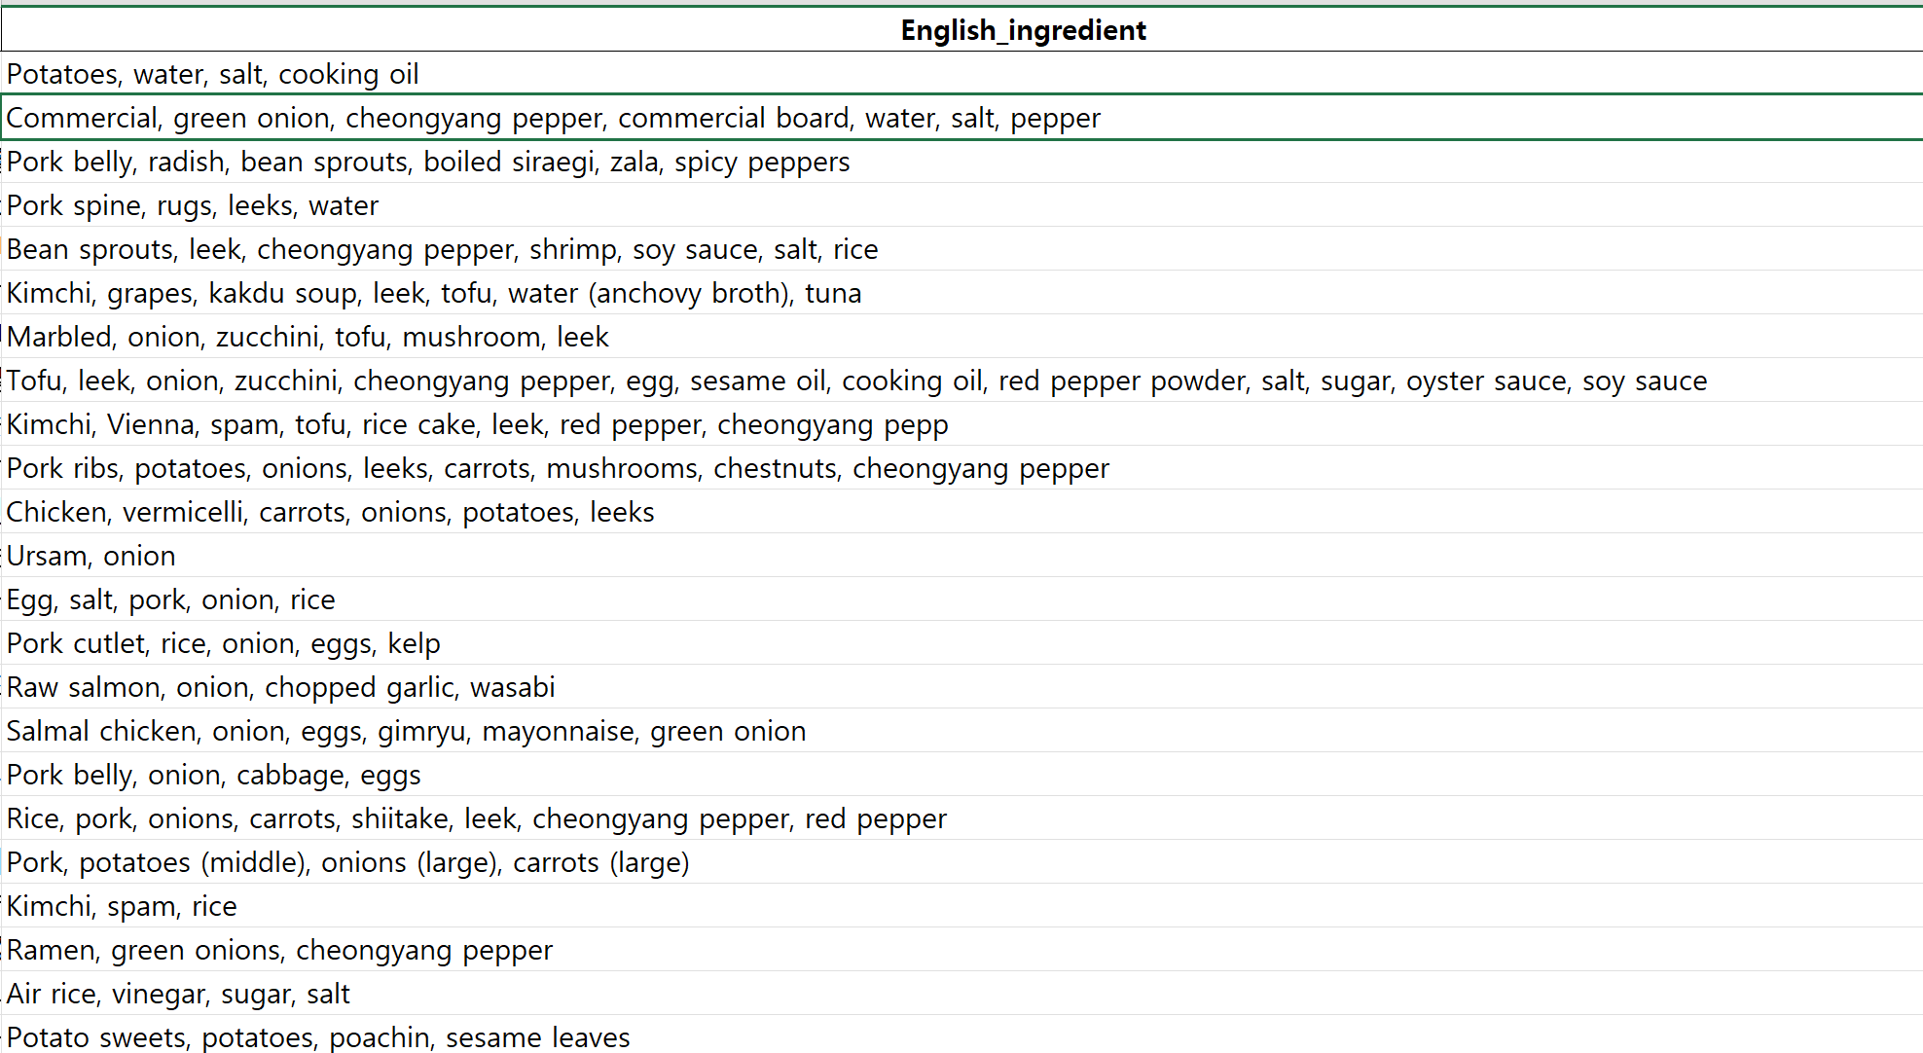
Overview of the model
Food Recommendation Based on Top-Ranked Similarities

Slide 38
We need two assignment
Data processing
Data modeling => Currently in progress

Slide 39
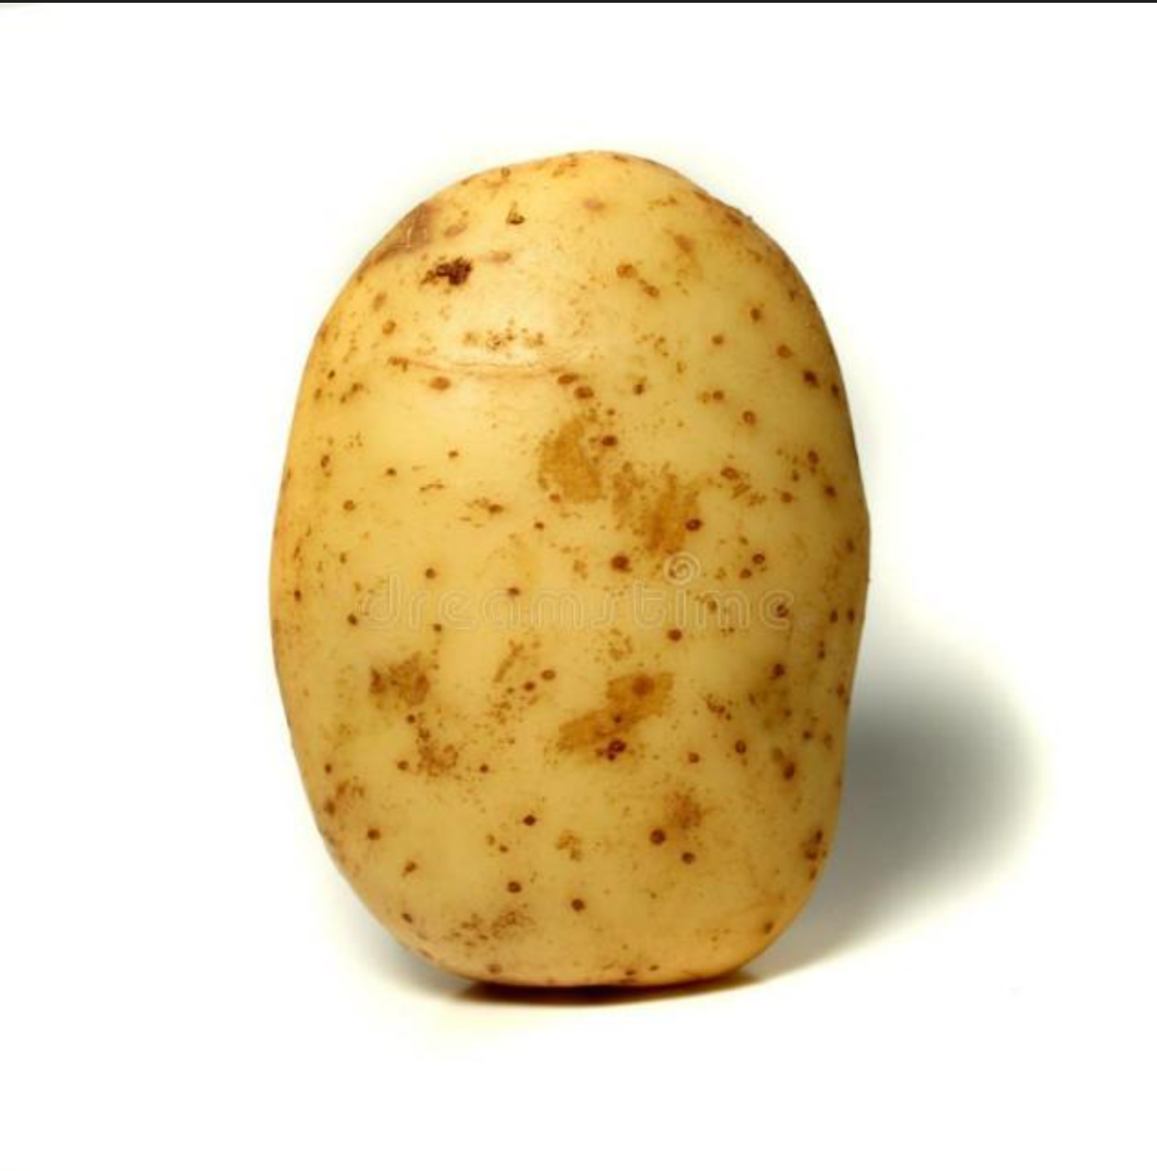
What data processing?
We need two kind of images for training
Standalone object image
Composite object image

Slide 40
Synthesis image
Why?
We need composite object image
That image associated with our food data

Slide 41
Overview of the model
Input
Standalone object images and bounding boxes for each ingredient
Background image
Output
Synthesised image, bounding boxes and label for each object

Slide 42
Overview of the model
Random extraction of n food items
Random extraction of photos for the selected food items
Randomly adjust image size (maintaining the aspect ratio, with defined maximum and minimum limits)
Photo composition and object information update

Slide 43
Problem of the model
The realism of the image decreases due to the boundary between the background and the images' backgrounds.

Slide 44
Problem of the model
Therefore, we are attempting to extract objects excluding the background from standalone object images using a segmentation model before composing the photos.

Slide 45
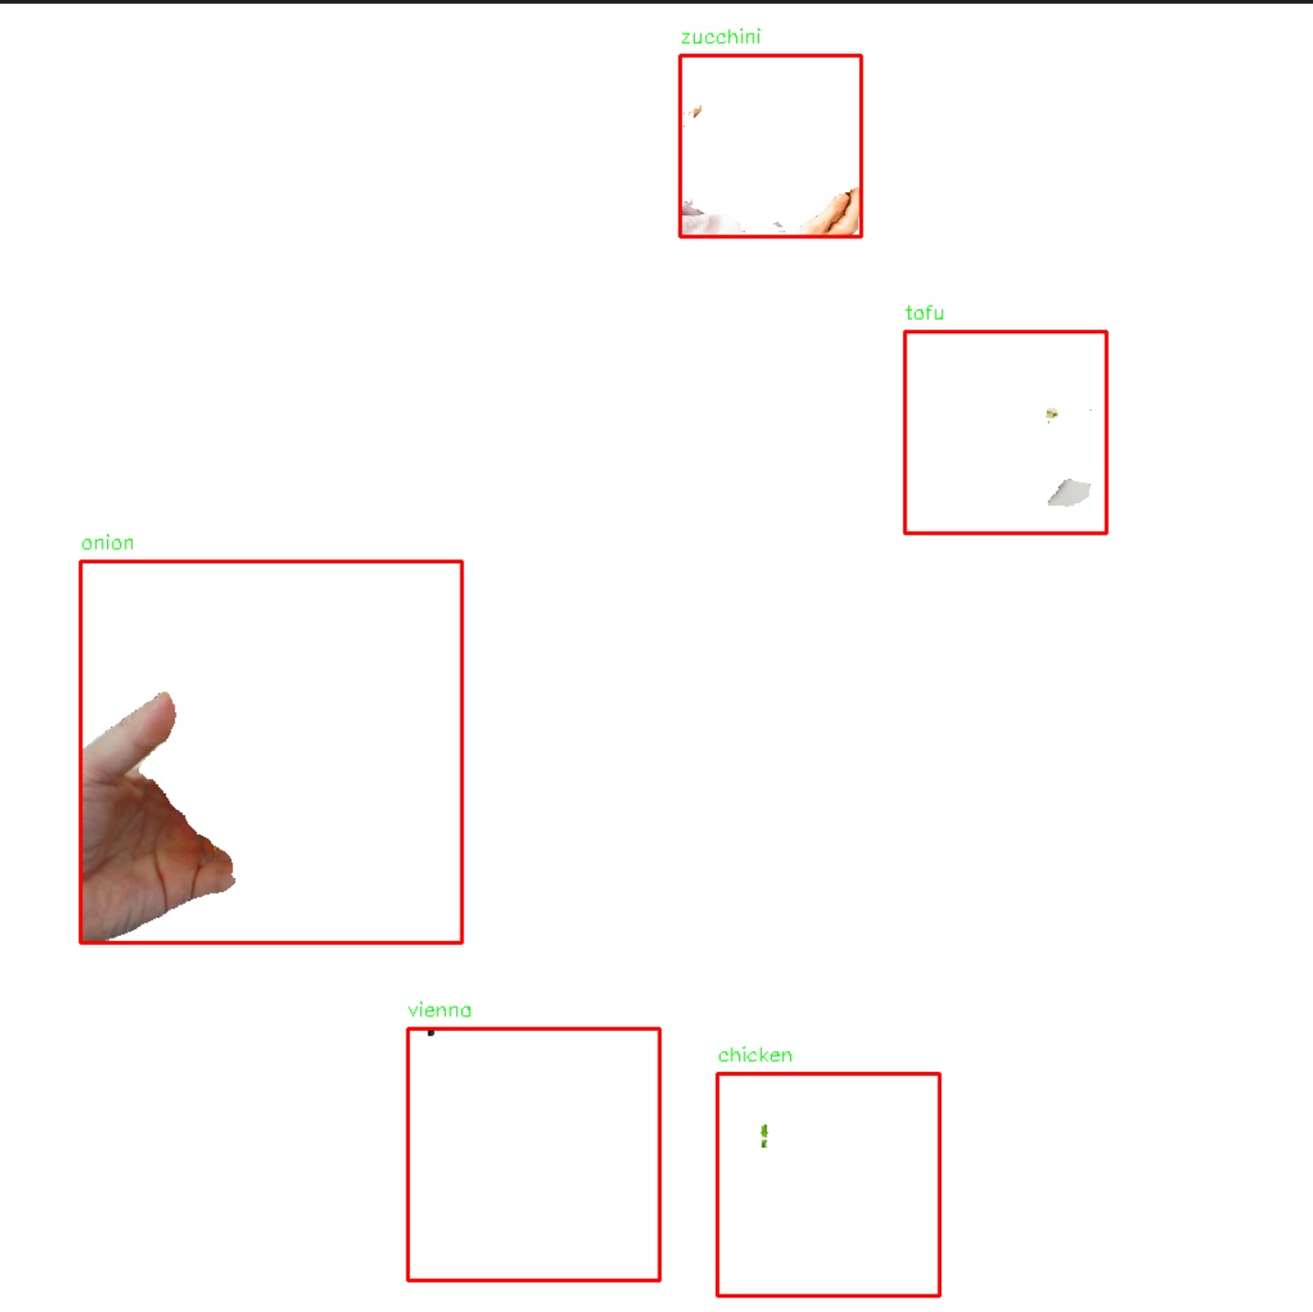
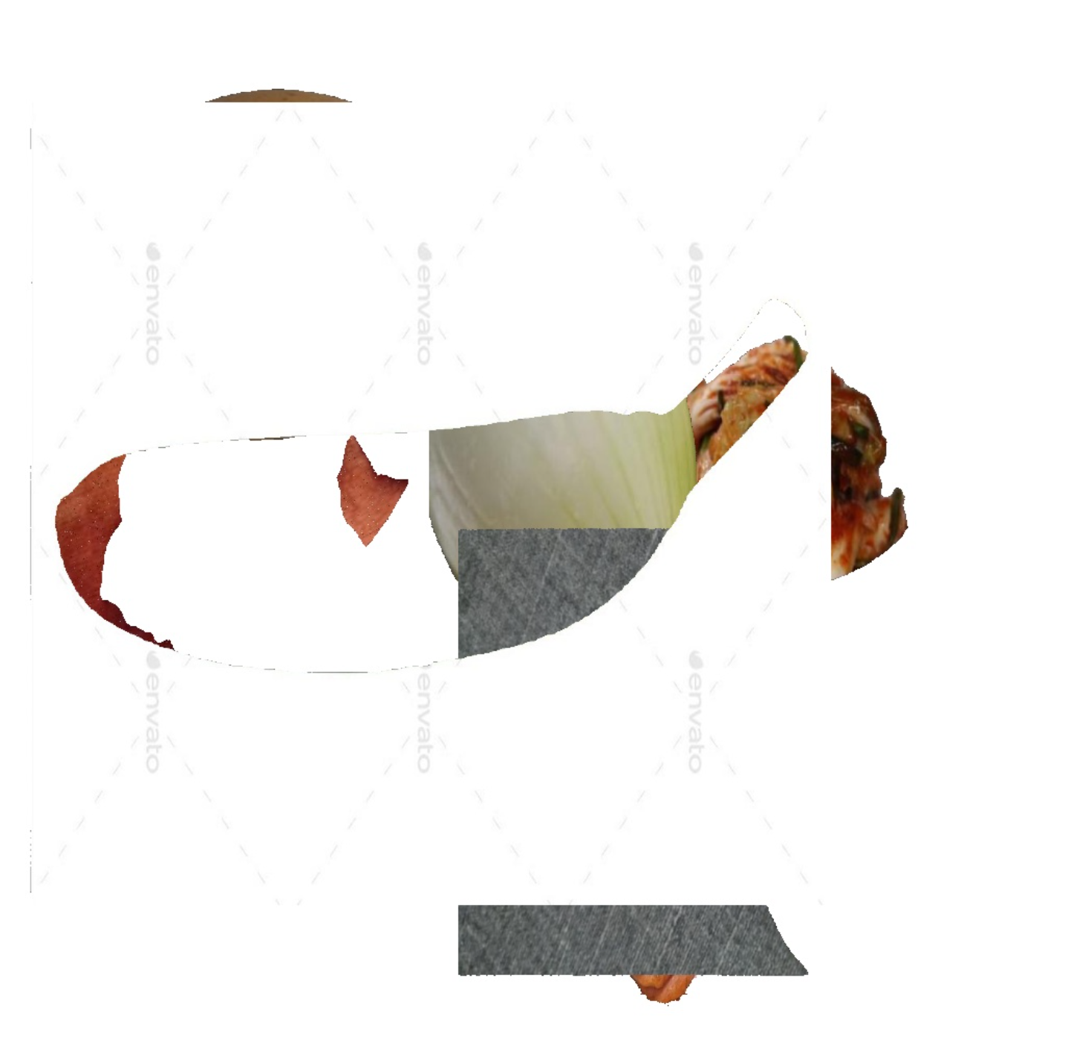
Problem of the model
However, the performance has not been satisfactory so far, and we are currently exploring solutions
Deep lab v3
SAM

Slide 46
03
Next week plan

Slide 47
Things to be done until next week
Frontend
AI
Backend
Integration, Make design more intuitive
Alpha test & beta test
=> Inhance UX and find bugs.
Fine tuning on segmentation
Train the image AI model and try it
Connect it with server
Integration, Fix bugs

Slide 48
THANK YOU

